Slide 1
23
Strategy Pattern
Trần Thị Anh Thư
Lê Tấn Đăng Tâm
Nguyễn Trọng Tùng
Lương Thế Văn

Slide 2
Design pattern summary
Design pattern
Creational pattern
Structural pattern
Behavioral pattern
E.g: Abstract Factory, Factory Method, Singleton,..
E.g: Adapter, Bridge, Composite,..
E.g: Interpreter, Template Method,...
Strategy pattern is a behavioral pattern!

Slide 3
Strategy pattern: Overview
Strategy pattern (aka the policy pattern) is a behavioral software design pattern that enables selecting an algorithm at runtime.
The strategy pattern:
Defines a family of algorithms
Encapsulates each algorithm
Makes the algorithms interchangeable within that family
Strategy pattern should be used in these following situations:
You have an easy-to-change code, and you separate them from the main program for easy maintenance
You want to avoid the hassle of having to implement a function over too many subclasses.
You want to change the algorithm used when running the program

Slide 4

Strategy pattern: Example
Before leaving us for a new universe, our beloved Stan Lee asked us to help him create another part of The Avenger: Civil War.
The part that we had to work on is to determine some main events in which we must tell which hero will fight against which hero and calculate remained health points to see who wins or loses.
Remember, each hero has their own abilities! (Iron Man can’t cast a spell like Wanda!)
As computer science students, we don’t merely present our ideas on paper. We prefer writing a C++ program for this, don’t we?

Slide 5
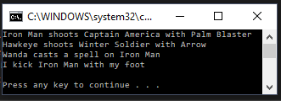
Strategy pattern: Example
This is what we want to be printed out to the screen

Slide 6

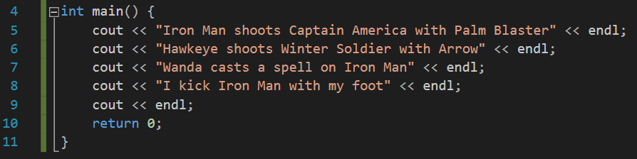
What we would do:
Strategy pattern: Example
I’m
Classic

Slide 7
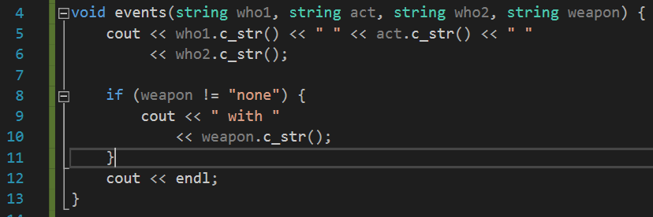
What we would do:
Strategy pattern: Example
I’m
Upgraded

Slide 8
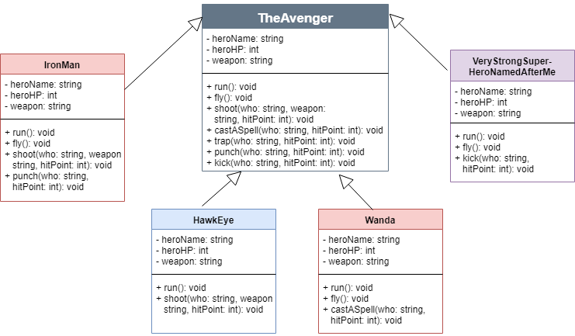
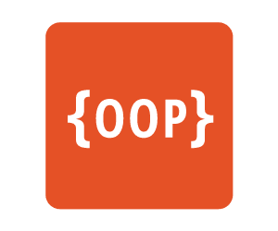

What we would do:
Strategy pattern: Example
I’m Advanced
<
Not virtual?
Virtual, not pure?
Pure virtual?
What if Tony Stark
could synthesize Wanda’s
power in mid-fight?

Slide 9
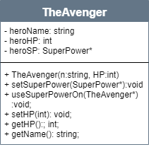
Apply Strategy Pattern
Strategy pattern: Example
I am
Vision!
What we actually SHOULD do:
Each Avenger HAS-A superPower
superPower can be of many abilities
Each Avenger fights with one ability at a time
And could change to other abilities on run-time.

Slide 10
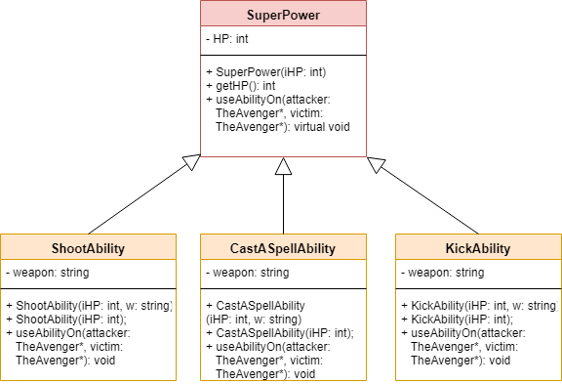
Applying Strategy Pattern
Strategy pattern: Example
I am
Vision!
SuperPower interface

Slide 11
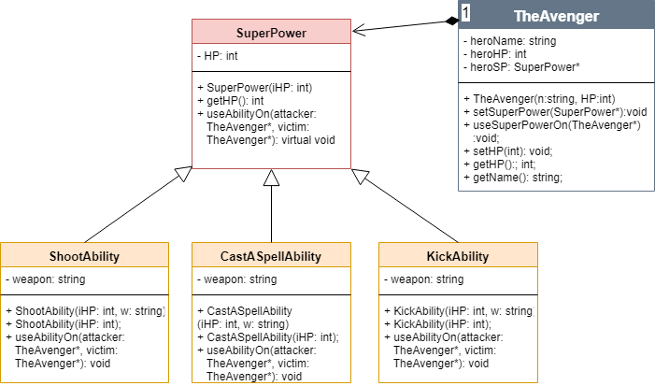
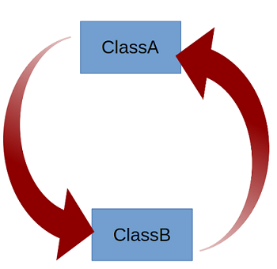
The whole picture:
Strategy pattern: Example
avenger.h
A.cpp
superpower.h
SP.cpp

Slide 12
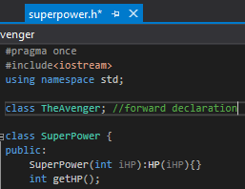
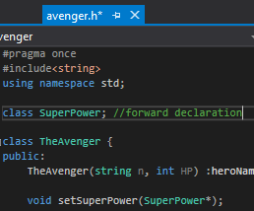


Forward declaration is our friend ;)
Strategy pattern: Example

Slide 13
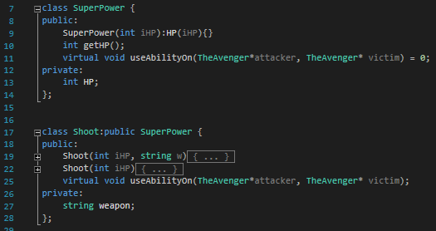
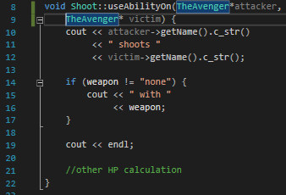
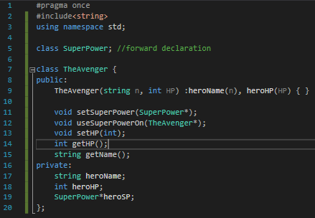
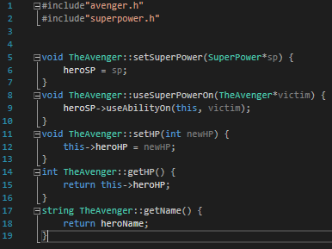
Code sample
Strategy pattern: Example
superpower.h | SP.cpp
avenger.h | A.cpp

Slide 14



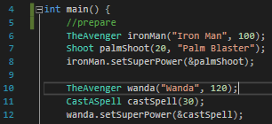






Code sample – Use it in main()
Strategy pattern: Example

Slide 15


Strategy pattern: Advantages & Disadvantages

Slide 16
Strategy pattern: Advantages
A family of algorithms can be defined as a class hierarchy and can be used interchangeably to alter application behavior without changing its architecture.
By encapsulating the algorithm separately, new algorithms complying with the same interface can be easily introduced.
The application can switch strategies at run-time.
Strategy enables the clients to choose the required algorithm, without using a “switch” statement or a series of “if-else” statements.
Data structures used for implementing the algorithm are completely encapsulated in Strategy classes. Therefore, the implementation of an algorithm can be changed without affecting the Context class.

Slide 17
Strategy pattern: Disadvantages
The application must be aware of all the strategies to select the right one for the right situation.
Context and the Strategy classes normally communicate through the interface specified by the abstract Strategy base class. Strategy base class must expose interface for all the required behaviors, which some concrete Strategy classes might not implement.
In most cases, the application configures the Context with the required Strategy object. Therefore, the application needs to create and maintain two objects in place of one.

Slide 18
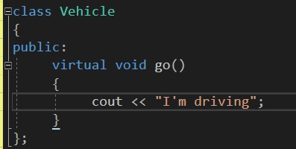
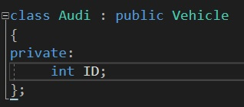
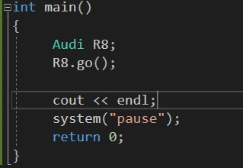

Strategy pattern: another example
Suppose you are working for a vehicle design company. You have a contract to design a car. Therefore you think about using OOP for your project. First you build a Vehicle class.
Then you build Audi class inherit from Vehicle class
So now you can create a Audi vehicle in main function and call the go function easily
result

Slide 19
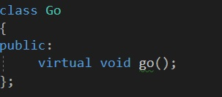
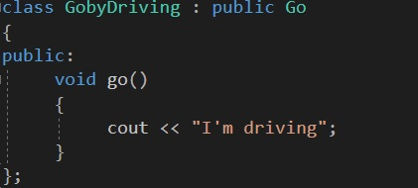
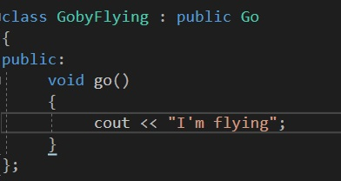
Strategy pattern: another example
Then your client want you to design for him a plane. You build another Plane class inherit from Vehicle class, since plane is also a vehicle. Then the problem is, how can a plane would be “driving”?
So you want to overwrite the Go function. But what if the client want to build many more vehicle?
It will be time-consuming to overwrite all that Go function.
The solution is to you strategy pattern.
First, you build a Go class.
Then, build GobyDriving class inherit from Go class. Same with GobyFlying.

Slide 20
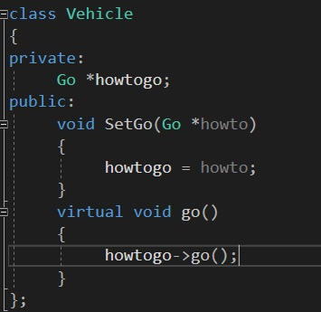
Strategy pattern: another example
Now you can add Go class in Vehicle class and set up function SetGo . This function will decide which Go algorithm you want to use.
From here, you just need to call the suitable Go algorithm for any vehicle you want!

Slide 21
Strategy pattern: Quiz
What type is Strategy pattern?
Creational pattern
B. Behavioral pattern
C. Structural pattern
D. None of the above
B. Behavioral pattern

Slide 22
Strategy pattern: Quiz
What type is Strategy pattern?
Creational pattern
B. Behavioral pattern
C. Structural pattern
D. None of the above
B. Behavioral pattern

Slide 23
23
Thank you for
listening!

